Slide 1

Website: Wanderlust
Team member:
Tanvi Sinha-200410107097
Darsh Shah-200410107104
Goswami Kaushikpari Mayurpari-200410107121
Submitted to-Proff.Shrina Patel

Slide 2


About website
Wanderlust is a website that provides reservation for hotel rooms.
This website contain all the offers and coupons for hotel rooms.
This website also contains gallery where you can view the place you want to visit and description of that place.
Users can also give their feedback by filling the feedback form which is available in the website. Also, the information filled in the form is further stored in the database.

Slide 3
TECHNOLOGY USED
HTML
CSS
HTML stands for Hypertext Markup Language.
HTML is the foundation of all web pages.
With tags and elements, we can define the headings, paragraphs, and other contents of a web page. Browsers come with a built-in stylesheet that visually differentiates these elements.
HTML’s anchor tags allow us to link pages to and from each other using the href attribute.
CSS stands for Cascading Style Sheets.
CSS saves a lot of work. It can control the layout of multiple web pages all at once.
With CSS, you can control the color, font, the size of text, the spacing between elements, how elements are positioned and laid out, what background images or background colors are to be used, different displays for different devices and screen sizes, and much more!

Slide 4
TECHNOLOGY USED
PHP
JAVASCRIPT
PHP can actually do anything related to server-side scripting or more popularly known as the backend of a website.
PHP can receive data from forms, generate dynamic page content, can work with databases, create sessions, send and receive cookies, send emails etc.
PHP can run on all major operating systems like Windows, Linux, Unix, Mac OS X etc. Almost all of the major servers available today like Apache supports PHP. PHP allows using wide range of databases.
Front-end developers use JavaScript (along with HTML and CSS) to create the parts of a web page that users see and interact with in their browsers.
JavaScript gave developers the ability to provide their users with a dynamic web experience, adding animations and other interactive elements.
JavaScript is also popular with back-end developers. Back-end web development (also known as server-side development) involves creating the code that runs on a web server.

Slide 5
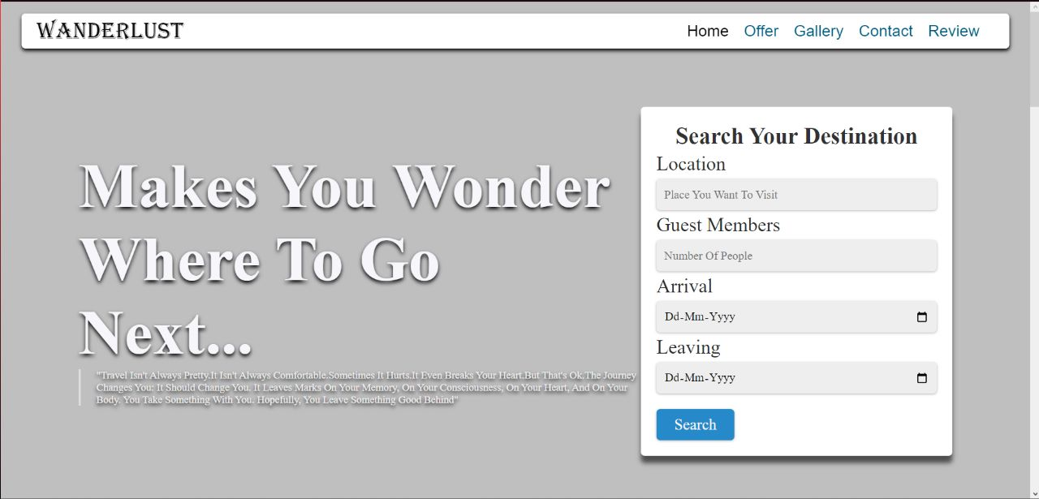
UI/UX SNAPSHOTS

Slide 6
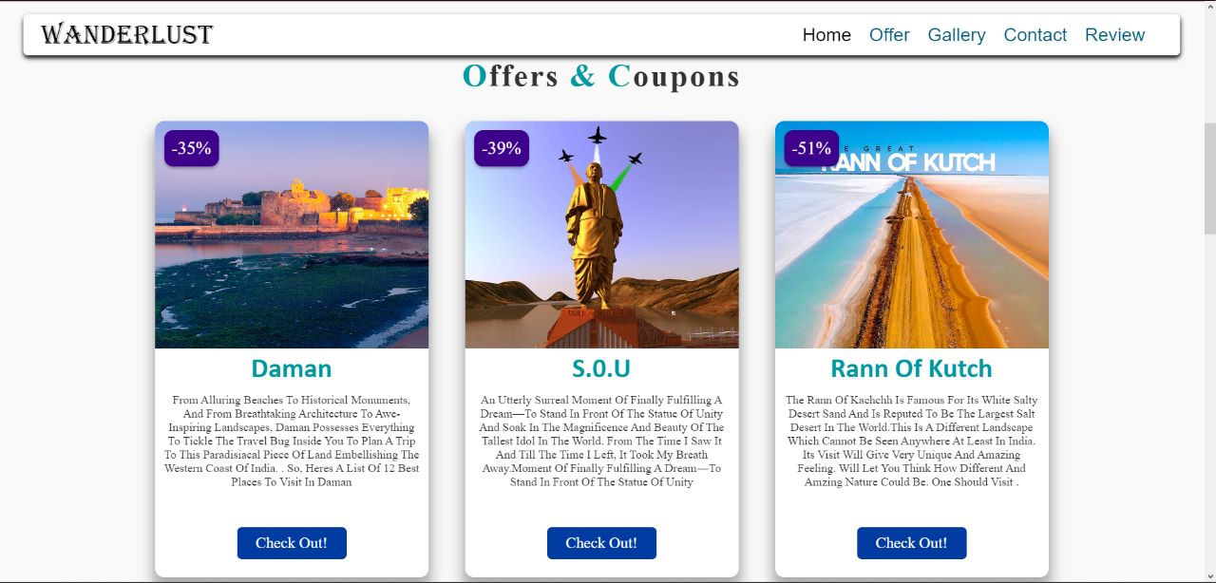

Slide 7
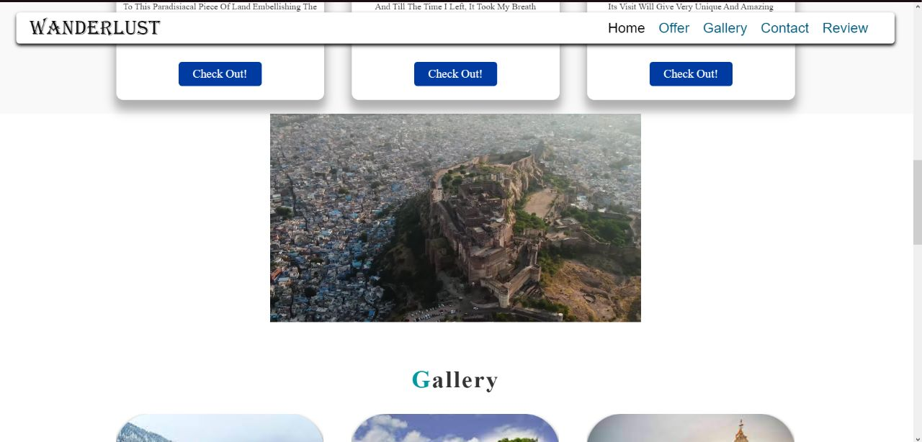

Slide 8
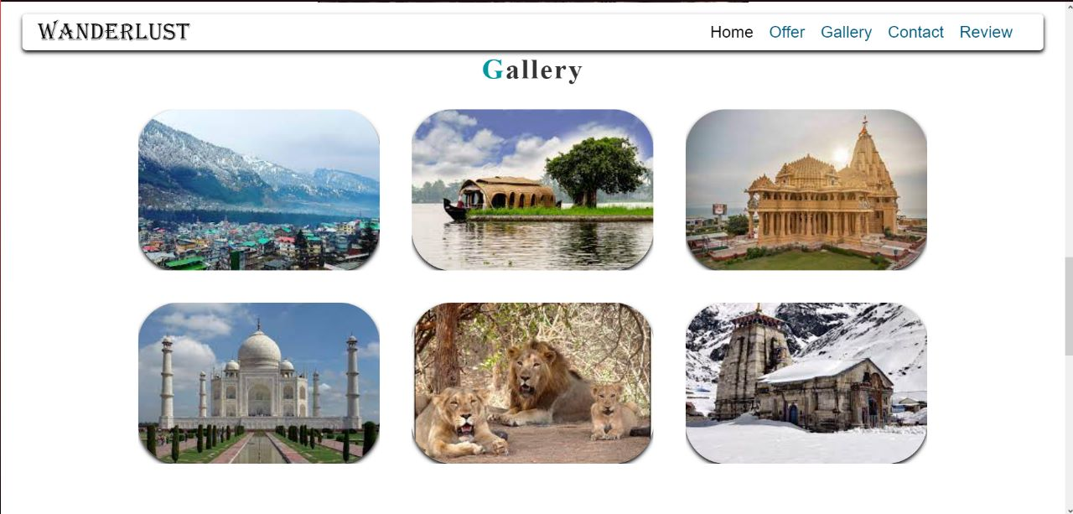

Slide 9
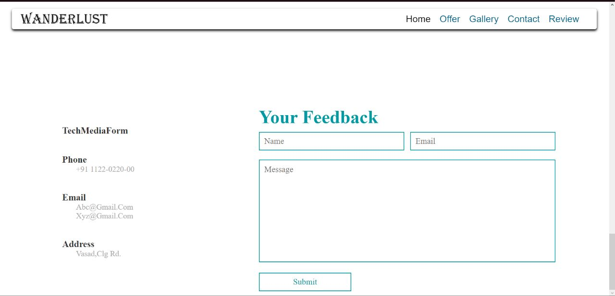

Slide 10


